Slide 1
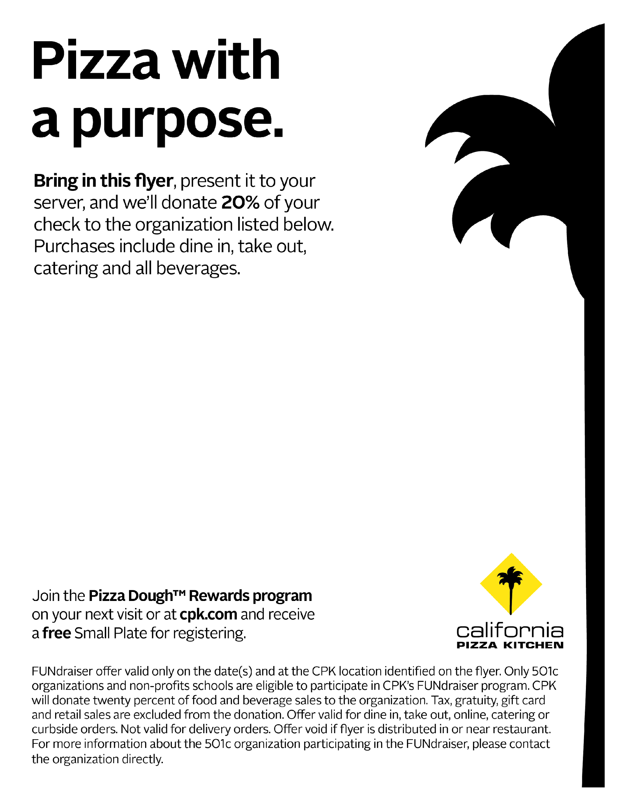
FUNdraiser in support of:
New eyes for the needy
December 14th , 2016. (Dine in or Takeout)
Valid at the participating location:
California Pizza Kitchen
1 Garden State Plaza
Paramus, NJ 07652
(Entrance 10 Between Neiman Marcus and Lord & Taylor)
(201) 587-0005
FUNdraiser offer valid only on the date(s) and at the CPK location identified on the flyer. Only 501c3 organizations and non-profits schools are eligible to participate in CPK’s FUNdraiser program. CPK will donate twenty percent of food and beverage sales to the organization. Tax, gratuity, gift card and retail sales are excluded from the donation. Offer valid for dine in, take out, online, catering or curbside orders. Not valid for delivery orders. Offer void if flyer is distributed in or near restaurant. For more information about the 501c3 organization participating in the FUNdraiser, please contact the organization directly.
Notes:
1

